Slide 1



MARKETING CAMPAIGN ANALYSIS FOR A PORTUGUESE BANK
DAB 004 Team #2

Slide 2





TEAM INTRODUCTION
Aesha Rathod
Isha Dhaduk
Jasleen Kour Chibber
Kunal Vaghela
Tanveer Kaur

Slide 3
INTRODUCTION
This project aims to analyze the marketing campaigns of a Portuguese banking institution.
The goal is to identify factors that influence the success of these campaigns and provide insights that can help improve future campaigns.
The dataset used in this analysis contains information on over 41,000 customers who were targeted in these campaigns.
We explored various features such as age, job, marital status, education level, and campaign outcome to determine their impact on campaign success.

Slide 4
BACKGROUND / MOTIVATION PROBLEM STATEMENT
Bank provides various Customer Services e.g. deposit, loans, credits and other financial terms.
Analyze to Identify financial trends
Manage risks and prevent frauds.
Inform development of new products.
Inform about client satisfaction and dissatisfactions about services.
Portuguese bank dataset is a real-life dataset that contains information on direct marketing campaigns of a Portuguese banking institution
The problem statement of the dataset is to predict whether a client will subscribe to a term deposit (binary classification) based on a set of demographic, economic, and social indicators.

Slide 5
DATASET OVERVIEW
The dataset contains information on 41,188 customers and 21 attributes.
There are both numerical and categorical features, including age, job, marital status, education level, and contact method.
The target variable is whether or not the customer subscribed to the bank's term deposit.
There are missing values in some of the features, which are handled during the data preprocessing stage.

Slide 6
ANALYSIS QUESTION?
How do customer demographics (such as age, income, or education level) impact their financial behavior?
What is the overall response rate for the marketing campaign?
Are customers with certain job types more likely to subscribe to the bank's term deposit?
Marital status is important for the success of the future campaign?

Slide 7


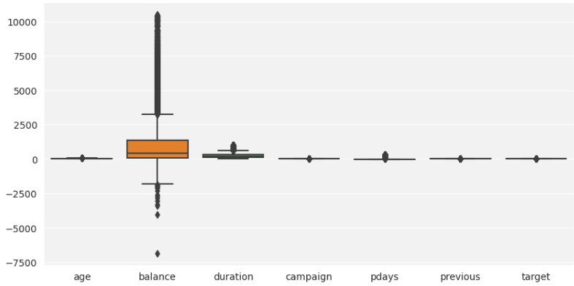
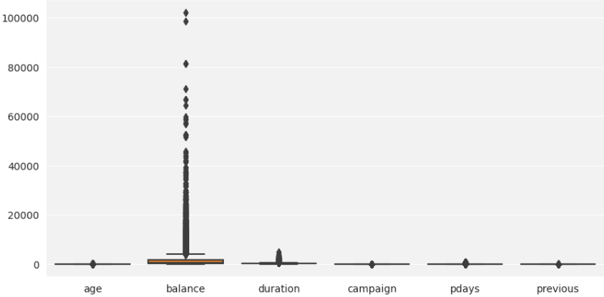
DATA PREPARATION
Cleaning the data, including handling missing values and outliers.
Filtered age from 18 to 60
Removed negative balance
Dropped the unused columns
Removed Outliers from duration
Renamed the ‘Y’ column to ‘Target’ column

Slide 8

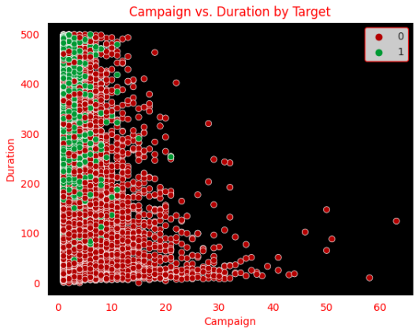
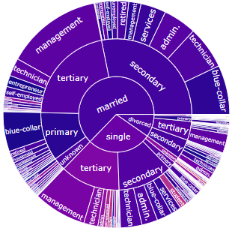
EXPLORATORY DATA ANALYSIS

Slide 9
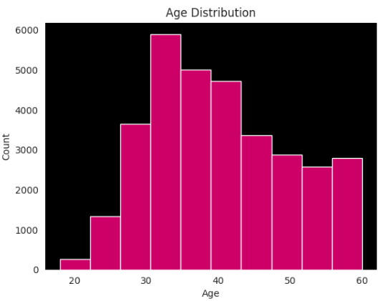
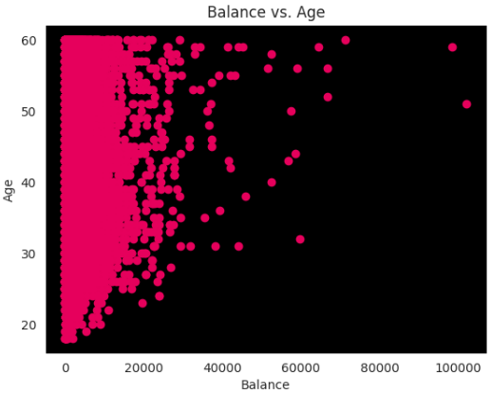
EXPLORATORY DATA ANALYSIS

Slide 10
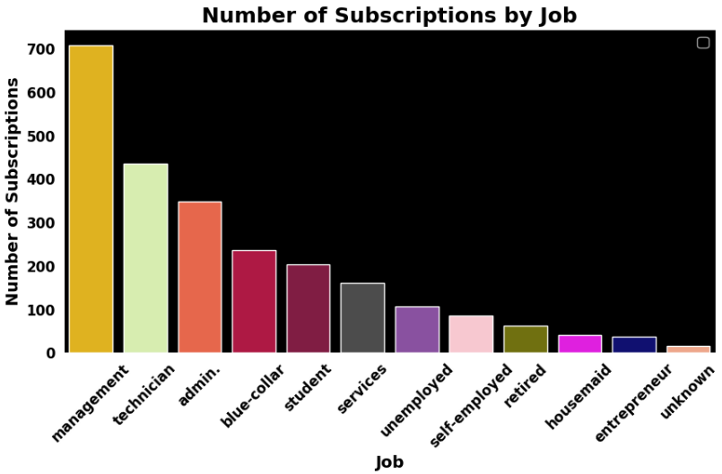
EXPLORATORY DATA ANALYSIS

Slide 11
MODELING
Logistic Regression model was used for predicting the success of marketing campaigns.
The model achieved a high accuracy score of 0.934, indicating a good performance in predicting the outcome.
The evaluation metric used to assess the performance was accuracy score, which measures the proportion of correctly classified instances out of total instances.
One-hot encoding was used to convert categorical variables into numerical ones.
Additional models were evaluated and compared to determine the best-performing model for this specific problem.

Slide 12
RECOMENDATIONS
Marketing team focus their efforts on customers with higher balances and lower ages, as they are more likely to subscribe to a term deposit.
Job type is important in predicting campaign success, so tailor calling based on target audience job type.
Machine learning can improve marketing campaign strategies, as indicated by our accurate models. The marketing team should continue exploring and leveraging these techniques.
Collect more data to improve the accuracy and generalizability of the model
Focus on: Higher Balance, Lower Age, Married, Job type and More duration.

Slide 13

CONCLUSION
In a nutshell, Through data cleaning, exploratory data analysis, and modeling, we found that age, balance, marital status, job type, and duration are important features in predicting campaign success.
Our Logistic Regression model achieved high accuracy, demonstrating the value of machine learning in predicting campaign success.
We provided actionable recommendations to improve campaign strategies based on our findings.

Slide 14
REFERENCES
Dataset: https://archive.ics.uci.edu/ml/datasets/bank+marketing
W3School: https://www.w3schools.com/python/matplotlib_intro.asp
Seaborn: https://seaborn.pydata.org/tutorial/introduction.html
GitHub Link of project
GitHub: Phase 3 - Recomendation and Conclusion

Slide 15

THANK YOU

